Slide 1
Chapter 12: Mass-Storage Systems

Slide 2
Chapter 12: Mass-Storage Systems
Overview of Mass Storage Structure
Disk Structure
Disk Attachment
Disk Scheduling
Disk Management
Swap-Space Management
RAID Structure
Disk Attachment
Stable-Storage Implementation
Tertiary Storage Devices
Operating System Issues
Performance Issues

Slide 3
Objectives
Describe the physical structure of secondary and tertiary storage devices and the resulting effects on the uses of the devices
Explain the performance characteristics of mass-storage devices
Discuss operating-system services provided for mass storage, including RAID and HSM

Slide 4
12.1 Overview of Mass Storage Structure
Magnetic disks provide bulk of secondary storage of modern computers
Drives rotate at 60 to 10,000 times per second
Transfer rate is rate at which data flow between drive and computer
Positioning time (random-access time) is time to move disk arm to desired cylinder (seek time) and time for desired sector to rotate under the disk head (rotational latency)
Head crash results from disk head making contact with the disk surface
That’s bad
Disks can be removable
Drive attached to computer via I/O bus
Busses vary, including EIDE, ATA, SATA, USB, Fibre Channel, SCSI
Host controller in computer uses bus to talk to disk controller built into drive or storage array

Slide 5
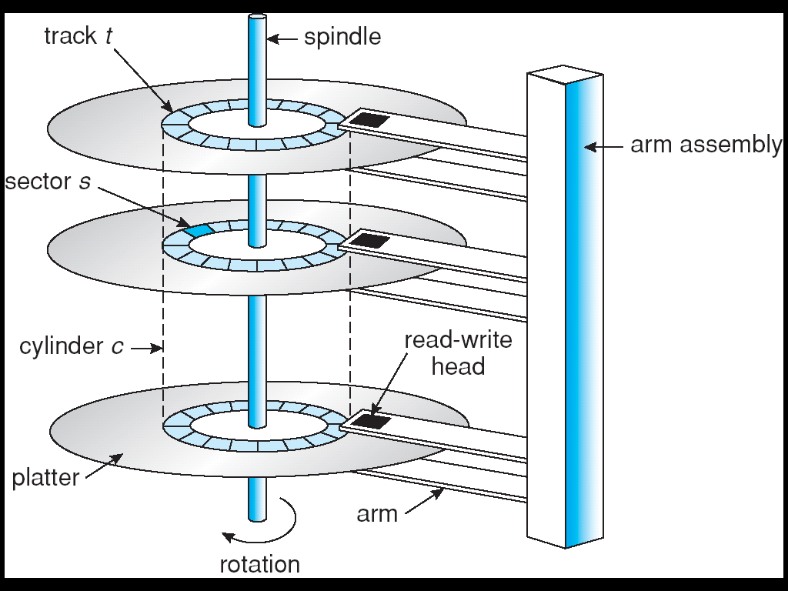
Moving-head Disk Machanism
写数据时，圆柱面优先。
即写满一个盘面上的一个磁道后，再写当前磁道上的下一个盘面；
以此类推；
当该磁道所有盘面都写满后，磁头臂移动到下一个磁道，继续上述过程。
读数据时，自然也按照写的顺序读取，也是按照圆柱面优先的原则。
问题：文件数据在磁盘上的写顺序？原因？
1、盘面优先：写满一个盘面上的所有磁道，然后写下一个盘面，以此类推
2、磁道优先：写满一个盘面上的当前磁道，然后写下一个盘面的同一个磁道

Slide 6
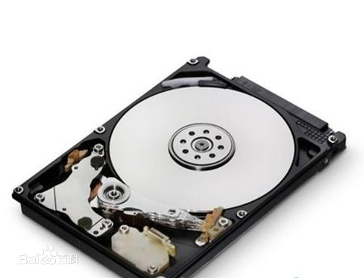
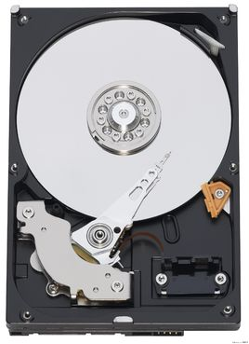
E.g. Disk drive

Slide 7
Overview of Mass Storage Structure (Cont.)
Magnetic tape (Chapter 12.1.2)
Was early secondary-storage medium
Relatively permanent and holds large quantities of data
Access time slow
Random access ~1000 times slower than disk
Mainly used for backup, storage of infrequently-used data, transfer medium between systems
Kept in spool and wound or rewound past read-write head
Once data under head, transfer rates comparable to disk
20-200GB typical storage
Common technologies are 4mm, 8mm, 19mm, LTO-2 and SDLT

Slide 8
12.2 Disk Structure
Disk drives are addressed as large 1-dimensional arrays of logical blocks, where the logical block is the smallest unit of transfer.
The 1-dimensional array of logical blocks is mapped into the sectors of the disk sequentially.
Sector 0 is the first sector of the first track on the outermost cylinder.
Mapping proceeds:
In order through that track, then the rest of the tracks in that cylinder;
And then through the rest of the cylinders from outermost to innermost.
顺序：一个盘面的一个磁道→同一个磁道上的下一个盘面→…→写完同一个磁道上的所有盘面→下一个磁道
理论上的写顺序：0号道，0号盘面，0号扇区→0号道，0号盘面，1号扇区→…；类似于三重循环中循环变量的变化规律

Slide 9
12.3 Disk Attachment 12.3.1 Host-Attached Storage
Host-attached storage accessed through I/O ports talking to I/O busses
SCSI itself is a bus, up to 16(15) devices on one cable, SCSI initiator requests operation and SCSI targets perform tasks
Each target can have up to 8 logical units (disks attached to device controller)
FC is high-speed serial architecture
Fiber Channel Arbitrated Loop-光纤通道仲裁环路可支持多达126个设备，SCSI只能在每个总线上支持15个设备。每个主适配器板带有二个FC-AL插口，很容易建立万亿字节的大容量存储;
光纤通道有一个较高的性能基线，即其每个环路的最大传输速率为100Mbytes/sec,它结合通道技术和网络技术从物理层到应用层的一系列协议提供更高的带宽，更长的连接距离和更灵活的连接方式；
Can be switched fabric with 24-bit address space – the basis of storage area networks (SANs) in which many hosts attach to many storage units
Can be arbitrated loop (FC-AL) of 126 devices

Slide 10
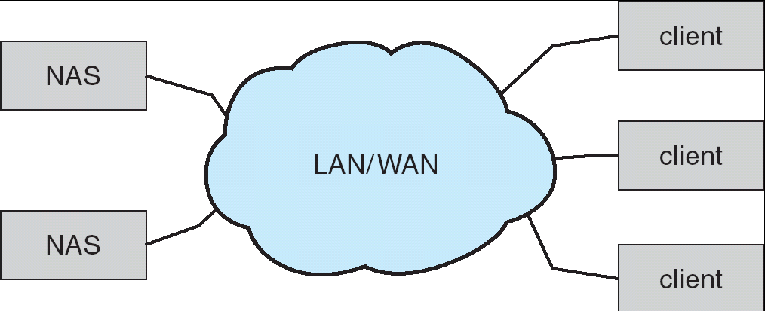
12.3.2 Network-Attached Storage
Network-attached storage (NAS) is storage made available over a network rather than over a local connection (such as a bus)
NFS and CIFS are common protocols
Implemented via remote procedure calls (RPCs) between host and storage
New iSCSI protocol uses IP network to carry the SCSI protocol

Slide 11
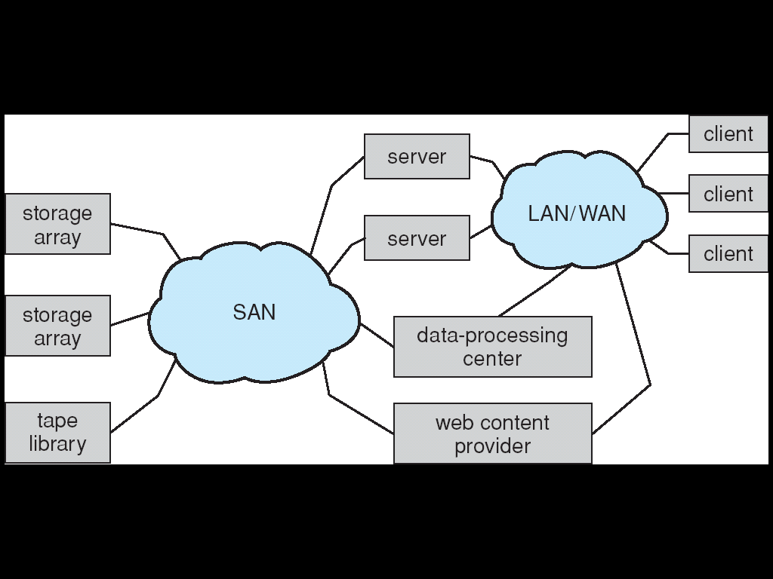
12.3.3 Storage Area Network
Common in large storage environments (and becoming more common)
Multiple hosts attached to multiple storage arrays - flexible

Slide 12
12.4 Disk Scheduling
The operating system is responsible for using hardware efficiently — for the disk drives, this means having a fast access time and disk bandwidth.
Access time has three major components
Seek time is the time for the disk are to move the heads to the cylinder containing the desired sector. (寻道—将磁头定位到磁道)
Rotational latency is the additional time waiting for the disk to rotate the desired sector to the disk head. (寻扇区—将磁头定位到扇区)
transfer time 指定扇区掠过磁头时，完成数据的读/写
Disk bandwidth is the total number of bytes transferred, divided by the total time between the first request for service and the completion of the last transfer.
Performance: Minimize seek time
Seek time ≈ seek distance
思考：为什么没有考虑查找盘面即track的时间？

Slide 13
Moving-head Disk Machanism
Access time has three major components
Seek time: the time for the disk are to move the heads to the cylinder containing the desired sector. (寻道—将磁头定位到磁道)
Rotational latency : the additional time waiting for the disk to rotate the desired sector to the disk head. (寻扇区—将磁头定位到扇区)
transfer time : 指定扇区掠过磁头时，完成数据的读/写
Performance: Minimize seek time
Seek time ≈ seek distance

Slide 14

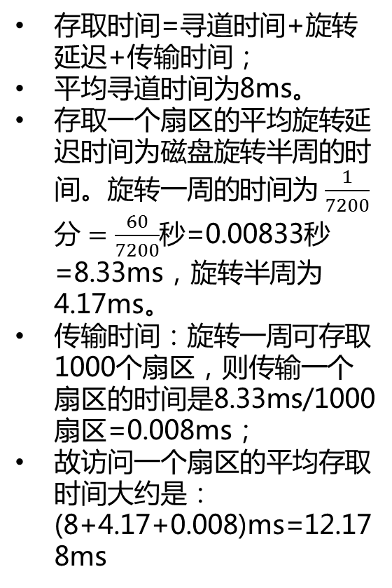
单选题
答案解析
1分
答案解析
若磁盘转速7200转/分，平均寻道时间为8ms，每个磁道包含1000个扇区，则访问一个扇区的平均存取时间大约是（）。
注：存取时间=寻道时间+旋转时间+传输时间
A
8.1ms
B
12.2ms （8+4.17+0.008=12.17ms）
C
16.3ms
D
20.5ms
提交
可为此题添加文本、图片、公式等解析，且需将内容全部放在本区域内。正常使用需3.0以上版本

Slide 15
Disk Scheduling (Cont.)
Performance: Minimize seek time
Seek time ≈ seek distance
Several algorithms exist to schedule the servicing of disk I/O requests.
We illustrate them with a request queue (0-199).
98, 183, 37, 122, 14, 124, 65, 67
Head pointer 53

Slide 16
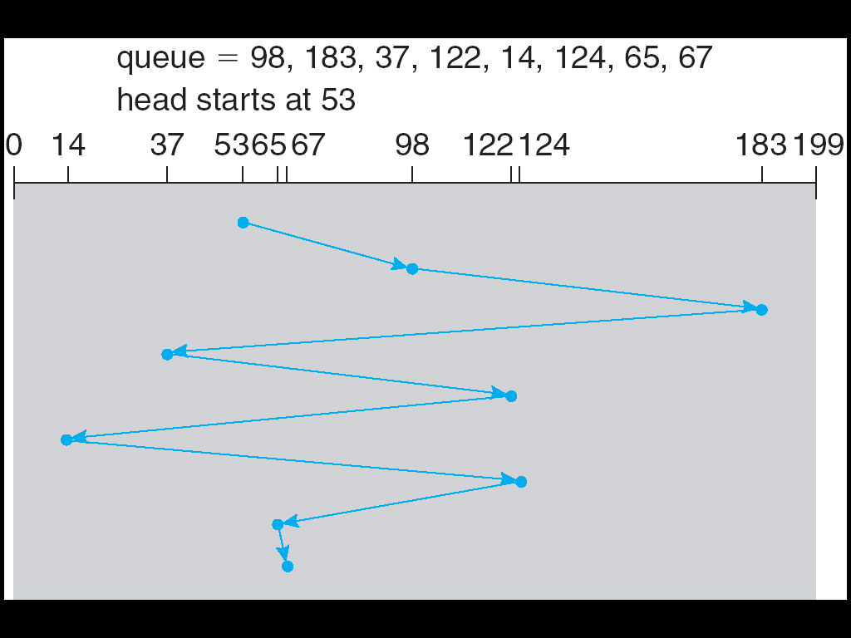
12.4.1 FCFS Scheduling
FCFS磁盘调度算法根据进程请求访问磁盘的的先后次序进行调度。
Illustration shows total head movement of 640 cylinders.

Slide 17
FCFS Scheduling (Cont.)
Simple, intrinsically fair, but generally does not provide the fastest service.
平均寻道距离大
磁臂来回摆动；
效率低；
Illustration shows total head movement of 640 cylinders.
(183-53)+(183-37)+(122-37)+(122-14)+(124-14)+(124-65)+(67-65)=640

Slide 18
12.4.2 SSTF Scheduling
Selects the request with the minimum seek time from the current head position.
SSTF scheduling is a form of SJF scheduling; may cause starvation of some requests.
Request queue: 98, 183, 37, 122, 14, 124, 65, 67
调度顺序： 53,65,67,37,14,98,122,124,183
Illustration shows total head movement of 236 cylinders.
(67-53)+(67-14)+(183-14)=236
贪心算法

Slide 19
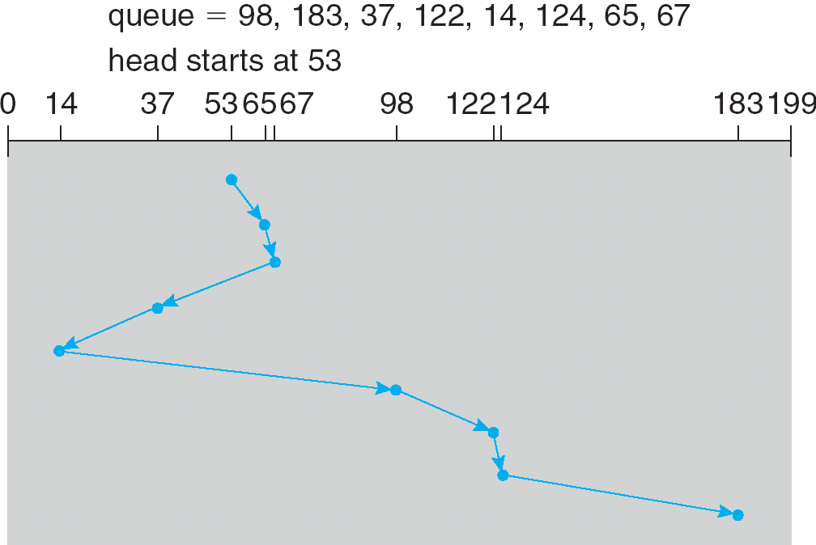
SSTF Scheduling (Cont.)

Slide 20
SSTF Scheduling (Cont.)
SSTF较之FCFS有更好的寻道性能，故过去一度被广泛采用过；
可能导致进程发生“饥饿”现象；
磁臂粘着；
不能保证平均寻道时间最短 (not optimal)
Request queue: 98, 183, 37, 122, 14, 124, 65, 67
SSTF调度顺序： 53,65,67,37,14,98,122,124,183
但如果调度顺序为：53,37,14,65,67,98,122,124,183
则 total head movement is 208 cylinders.
(53-14)+(183-14)=208 (c.f. SSTF:236)
SSTF is common and has a natural appeal

Slide 21
12.4.3 SCAN Scheduling
The disk arm starts at one end of the disk, and moves toward the other end, servicing requests until it gets to the other end of the disk, where the head movement is reversed and servicing continues.
Sometimes called the elevator algorithm.
Head’s current position:53
The direction of head movement: the disk arm is moving toward 0
Request queue: 98, 183, 37, 122, 14, 124, 65, 67

Slide 22
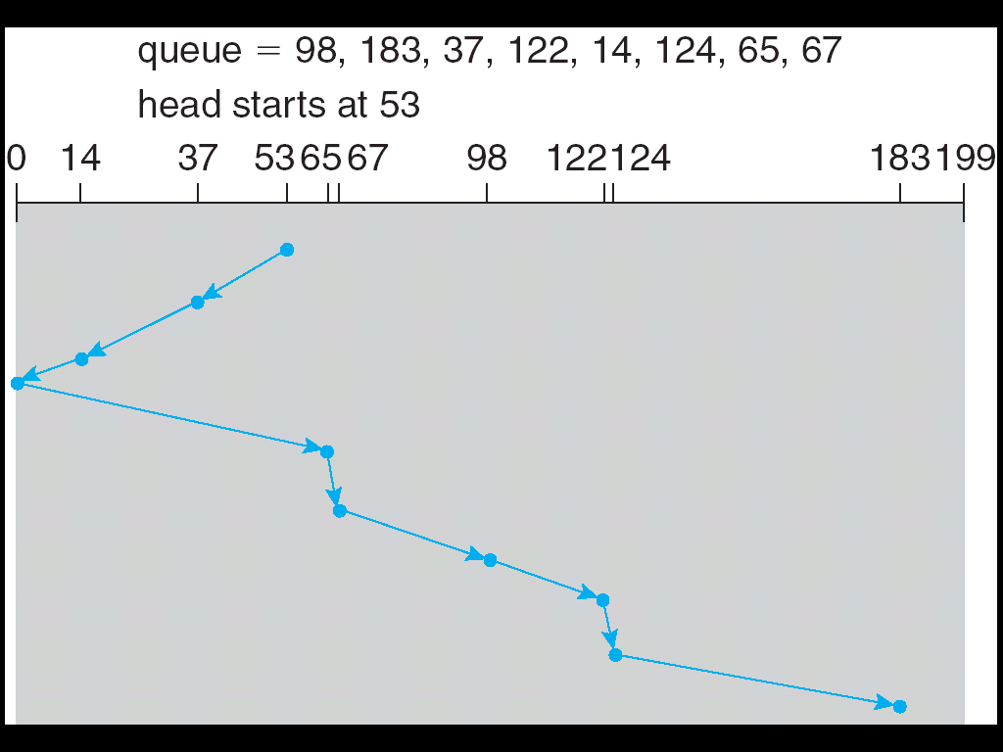
SCAN Scheduling (Cont.)

Slide 23
SCAN Scheduling (Cont.)
Head’s current position: 53
The direction of head movement: the disk arm is moving toward 0
Request queue: 98, 183, 37, 122, 14, 124, 65, 67
调度顺序是： 53,37,14,0,65,67,98,122,124,183
Illustration shows total head movement of 236 cylinders.
(53-0)+(183-0)=236
注：汤子瀛的教材中
Scan算法 调度顺序是：53,37,14,65,67,98,122,124,183
Illustration shows total head movement of 208 cylinders.
(53-14)+(183-14)=208

Slide 24
SCAN Scheduling (Cont.)
两个要点：
Head’s current position (磁头当前位置)
The direction of head movement (磁头当前移动方向)
与SSTF相比，避免进程出现“饥饿”现象；
SCAN perform better for systems that place a heavy load on the disk.
若磁盘服务请求均匀地分布在各个柱面上，当磁头到达一端折返往回移动时，在该端等待服务的请求可能很少，等待的时间也比较短，因为该区域的请求刚刚被访问过；
而另一端等待服务的请求可能很多，等待的时间也可能很长；
解决方案：另一端的等待时间脚长的请求应该优先得到服务；

Slide 25
12.4.4 C-SCAN Scheduling
Provides a more uniform wait time than SCAN.
The head moves from one end of the disk to the other. servicing requests as it goes. When it reaches the other end, however, it immediately returns to the beginning of the disk, without servicing any requests on the return trip.
Treats the cylinders as a circular list that wraps around from the last cylinder to the first one.
C－SCAN－规定磁头单向移动。系统沿着一个方向（例如由内向外），依次对请求进行服务，到达最外端后，磁头立即返回到最内端，然后再由里向外依次对请求进行服务。

Slide 26
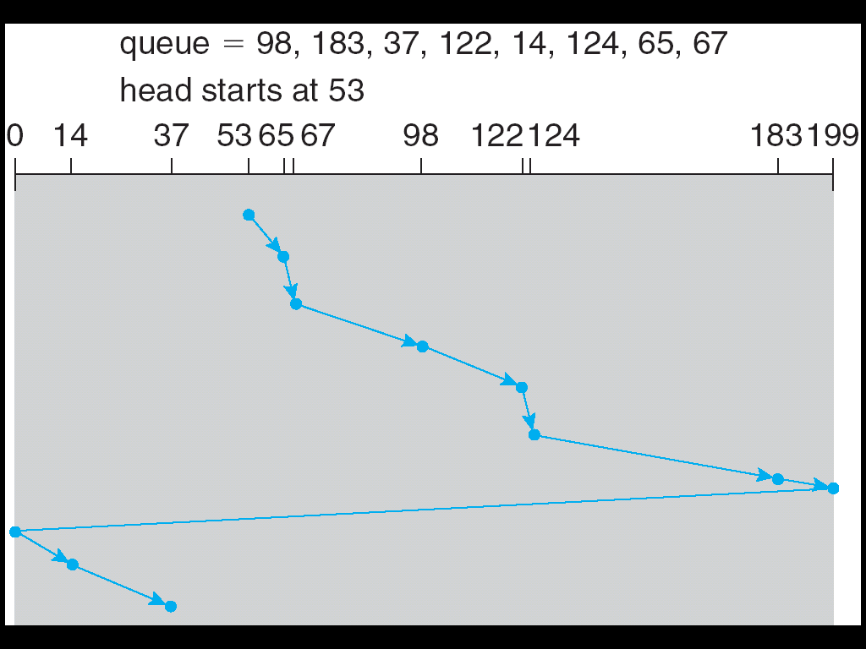
C-SCAN Scheduling (Cont.)

Slide 27
C-SCAN Scheduling (Cont.)
与SCAN相比，公平
C-SCAN perform better for systems that place a heavy load on the disk.
假定磁盘的最外道号为199，最内道号为0
Head’s current position: 53
The direction of head movement: the disk arm is moving toward 199
Request queue: 98, 183, 37, 122, 14, 124, 65, 67
调度顺序：53,65,67,98,122,124,183,199,0,14,37
Illustration shows total head movement of 382 cylinders.
(199-53)+(199-0)+(37-0)=382

Slide 28
12.4.5 LOOK Scheduling
Version of SCAN or C-SCAN implantation
As described above, both SCAN and C-SCAN move the disk arm across the full width of the disk.
In practice, arm only goes as far as the last request in each direction, then reverses direction immediately, without first going all the way to the end of the disk.
SCAN → Look
C-SCAN → C-Look

Slide 29
LOOK Scheduling

Slide 30
LOOK Scheduling
与SCAN 相比，提高了效率；
Head’s current position: 53
The direction of head movement: the disk arm is moving toward 0
Request queue: 98, 183, 37, 122, 14, 124, 65, 67
调度顺序是：53,37,14,65,67,98,122,124,183
Total head movement of 208 cylinders.
(53-14)+(183-14)=208
汤子赢教材中，SCAN即Look

Slide 31
C-LOOK Scheduling
Version of C-SCAN
Arm only goes as far as the last request in each direction, then reverses direction immediately, without first going all the way to the end of the disk.
假定磁盘的最外道号为 199，最内道号为 0
Head’s current position: 53
The direction of head movement: the disk arm is moving toward 199

Slide 32
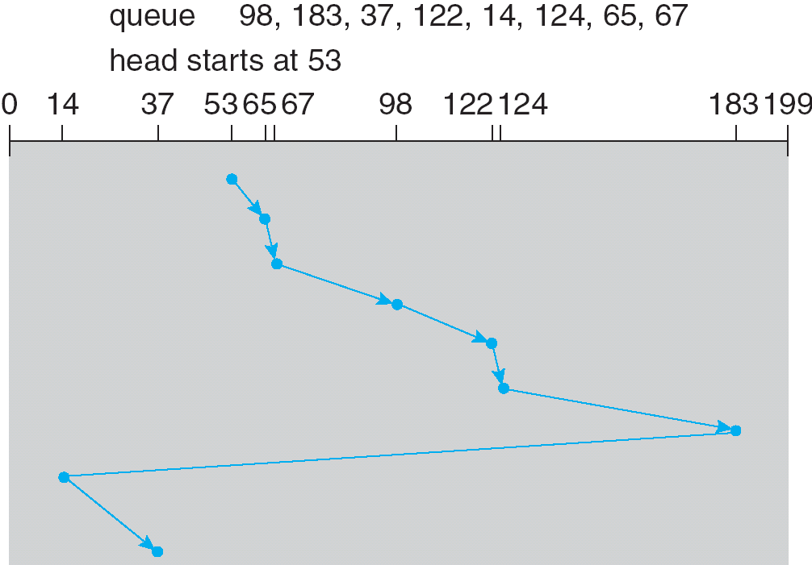
C-LOOK Scheduling (Cont.)

Slide 33
C-LOOK Scheduling
Version of C-SCAN
Arm only goes as far as the last request in each direction, then reverses direction immediately, without first going all the way to the end of the disk.
C-SCAN相比，提高了效率；
假定磁盘的最外道号为 199，最内道号为 0
Head’s current position: 53
The direction of head movement: the disk arm is moving toward 199
Request queue: 98, 183, 37, 122, 14, 124, 65, 67
调度顺序是：53,65,67,98,122,124,183,14,37
Illustration shows total head movement of 322 cylinders.
(183-53)+(183-14)+(37-14)=322

Slide 34
注
国内的资料将SCAN与C-SCAN按照LOOK与C-LOOK的思想介绍。
例如汤子瀛书中，SCAN即LOOK， CSCAN即C-LOOK；
注意磁臂移动距离的计算；

Slide 35
单选题
答案解析
1分
答案解析
此题未设置答案，请点击右侧设置按钮
某硬盘有200个磁道（最外侧磁道号为0），磁道访问请求序列为130,42,180,15,199，当前磁头位于第58号磁道并从外侧向内侧移动。
按照SCAN调度方法处理完上述请求后，磁头移过的磁道数是（）。
C
(199-58)+(199-15)=325
汤子瀛书中，SCAN即为LOOK。
国内基本认可这种观点
A
208
B
287
C
325
D
382
提交
可为此题添加文本、图片、公式等解析，且需将内容全部放在本区域内。正常使用需3.0以上版本

Slide 36
单选题
答案解析
1分
答案解析
此题未设置答案，请点击右侧设置按钮
假设磁头当前位于第105道，正在向磁道序号增加的方向移动。现有一个磁道访问请求序列为35,45,12,68,110,180,170,195，采用SCAN调度（电梯调度）算法得到的磁道访问序列是（）。
A
若严格按照教材中的SCAN调度算法，应该移到磁盘边缘后再往回折返。
汤子瀛书中，SCAN即为LOOK。
国内基本认可这种观点
A
110,170,180,195,68,45,35,12
B
110,68,45,35,12,170,180,195
C
110,170,180,195,12,35,45,68
D
12,35,45,68,110,170,180,195
提交
可为此题添加文本、图片、公式等解析，且需将内容全部放在本区域内。正常使用需3.0以上版本

Slide 37
12.4.6 Selecting a Disk-Scheduling Algorithm
SSTF is common and has a natural appeal
SCAN and C-SCAN perform better for systems that place a heavy load on the disk.
Performance depends on the number and types of requests.
Requests for disk service can be influenced by the file-allocation method.
连续文件性能最好；链接及索引文件可能需要再次寻道移动
The disk-scheduling algorithm should be written as a separate module of the operating system, allowing it to be replaced with a different algorithm if necessary.
Either SSTF or LOOK is a reasonable choice for the default algorithm.

Slide 38
习 题 P489 12.2
Suppose that a disk drive has 5000 cylinders, numbered 0 to 4999. The drive is currently serving a request at cylinder 143, and the previous request was at cylinder 125. The queue of pending requests, in FIFO order, is: 86, 1470, 913, 1774, 948, 1509, 1022, 1750, 130 . Starting from the current head position, what is the total distance (in cylinders) that the disk arm moves to satisfy all the pending requests, for each of the following disk-scheduling algorithms?
a. FCFS
b. SSTF
c. SCAN
d. LOOK
e. C-SCAN
f. C-LOOK

Slide 39
习 题 P489 12.2 –参考答案
a. The FCFS schedule is 143, 86, 1470, 913, 1774, 948, 1509, 1022, 1750, 130. The total seek distance is 7081.
b. The SSTF schedule is 143, 130, 86, 913, 948, 1022, 1470, 1509, 1750, 1774. The total seek distance is 1745.
c. The SCAN schedule is 143, 913, 948, 1022, 1470, 1509, 1750, 1774, 4999, 130, 86. The total seek distance is 9769.
d. The LOOK schedule is 143, 913, 948, 1022, 1470, 1509, 1750, 1774, 130, 86. The total seek distance is 3319.
e. The C-SCAN schedule is 143, 913, 948, 1022, 1470, 1509, 1750, 1774, 4999, 86, 130. The total seek distance is 9813.（如严格按照教材中的C-SCAN，应该从4999，0）
f. The C-LOOK schedule is 143, 913, 948, 1022, 1470, 1509, 1750, 1774, 86, 130. The total seek distance is 3363.

Slide 40
主观题
10分
假设计算机系统采用CSCAN磁盘调度策略，使用2KB的内存空间记录16384个磁盘块的空闲状态。
（1）请说明在上述条件下如何进行磁盘块空闲状态管理。
（2）设某单面磁盘旋转速度为6000转/分钟。每个磁道有100个扇区，相邻磁道间的平均移动时间为1ms。若在某时刻，磁头位于100号磁道处，并沿着磁道号大的方向移动。磁道号请求队列为50、90、30、120，对请求队列中的每个磁道需读取一个随机分布的扇区，则读完这4个扇区共需要多少时间？给出计算过程。
（3）如果将磁盘替换为随机访问的Flash半导体存储器（如U盘，SSD盘等），是否有比CSCAN更有效的磁盘调度策略？若有，给出磁盘调度策略的名称并说明理由；若无，说明理由。
正常使用主观题需2.0以上版本雨课堂
作答

Slide 41
续上页
（1）可采用位示图法表示磁盘块的空闲状态。二进制0表示磁盘块空闲，1表示已分配。16384的磁盘块共占用16384bit=16384/8B=2048B=2KB，可满足使用2KB的内存空间记录16384个磁盘块的空闲状态的要求。
（2）读完这4个扇区共需要多少时间包括三部分：寻道时间，旋转延迟时间，及扇区存取时间。
采用CSCAN磁盘调度算法，磁道的访问顺序为120,3050,90，访问过程中移动的磁道总数为(120-100)+(120-30)+(90-30)=170，故总的寻到时间为170*1ms=170ms；（按汤子瀛书中，C-SCAN即为C-LOOK）
旋转一圈需要1/6000分钟=10ms，随机访问一个扇区的平均旋转延迟时间为(0+10)ms/2=5ms，访问4个扇区需要5ms*4=20ms；
每个磁道有100个扇区，则读取一个扇区的时间需要10ms/100=0.1ms，读取4个扇区需要0.1ms*4=0.4ms；
综上，磁盘访问总时间为170ms+20ms+0.4ms=190.4ms
（3）采用FCFS调度比CSCAN更有效。因为Flash半导体存储器不需要考虑寻道和旋转延迟，可直接按照I/O的请求顺序服务。

Slide 42
单选题
答案解析
1分
答案解析
下列选项中，不能改善磁盘I/O性能的是（）。
此题未设置答案，请点击右侧设置按钮
B
滞后写：如果一个文件块被修改过，将来需要写回磁盘，防止数据丢失。
采用Disk Cache（memory mapped I/O）技术，没有必要磁盘块被修改后接着写回，而是等多次修改且被置换后才写回，以尽量减少磁盘的访问频率。
A
重排I/O请求次序
B
在一个磁盘上设置多个分区
C
预读和滞后写
D
优化文件物理块的分布
提交
可为此题添加文本、图片、公式等解析，且需将内容全部放在本区域内。正常使用需3.0以上版本

Slide 43
12.5 Disk Management
Low-level formatting, or physical formatting — Dividing a disk into sectors that the disk controller can read and write.
To use a disk to hold files, the operating system still needs to record its own data structures on the disk.
Partition the disk into one or more groups of cylinders.
Logical formatting or “making a file system”.
Boot block initializes system.
The bootstrap is stored in ROM.
Bootstrap loader program.
Methods such as sector sparing used to handle bad blocks.

Slide 44
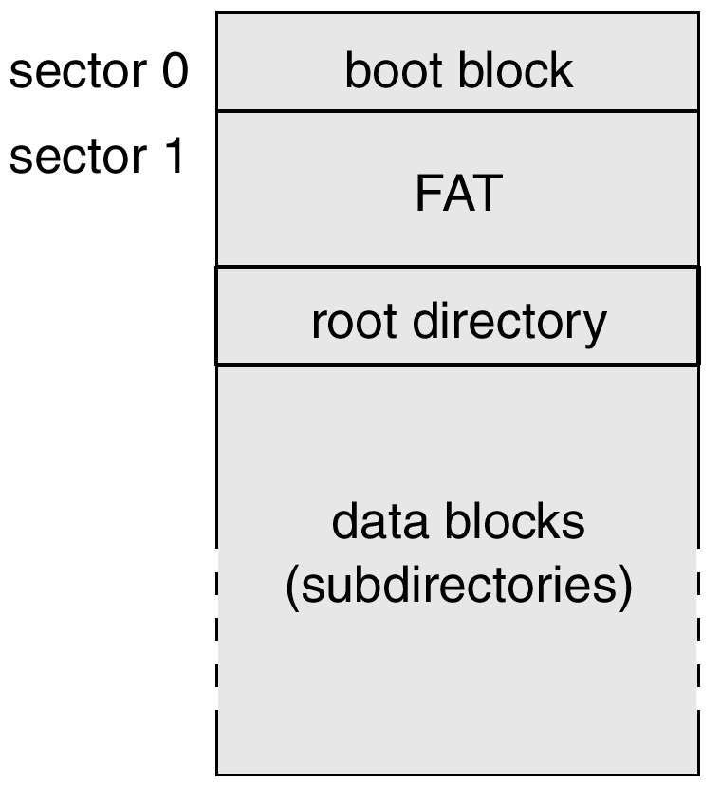
MS-DOS Disk Layout

Slide 45
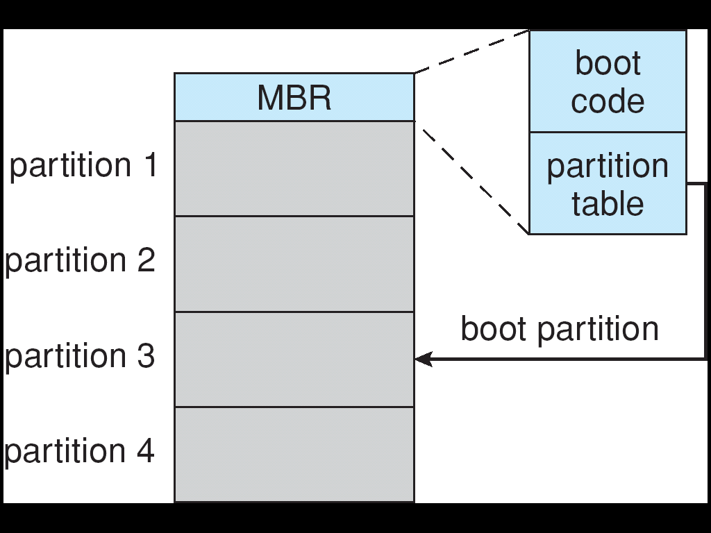
Booting from a Disk in Windows 2000
MBR-Master
Boot
Record

Slide 46
Swap-Space Management
Swap-space — Virtual memory uses disk space as an extension of main memory.
Swap-space can be carved out of the normal file system, or, more commonly, it can be in a separate disk partition.
Swap-space management
4.3BSD allocates swap space when process starts; holds text segment (the program) and data segment.
Kernel uses swap maps to track swap-space use.
Solaris 2 allocates swap space only when a page is forced out of physical memory, not when the virtual memory page is first created.

Slide 47
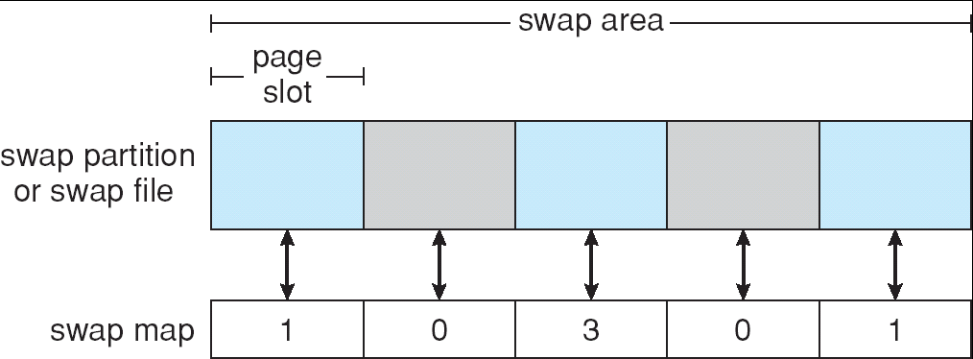
Data Structures for Swapping on Linux Systems
In swap map, the value of the counter is
0—indeicates the corresponding page slot is available
1—indeicates the swapped page is mapped to a process
3—indeicates the swapped page is mapped to three different processes
(the swapped page is storing a region of memory shared by three processes)

Slide 48
12.7 RAID Structure
磁盘容错技术，也称为系统容错技术
￭ SFT-I 低级磁盘容错技术
防止磁盘表面发生缺陷所引起的数据丢失；
￭ SFT-II 中级磁盘容错技术 （RAID）
防止磁盘驱动器和磁盘控制器故障所引起的系统不能正常工作；
￭ SFT-III 高级磁盘容错技术
机器或系统出现故障；

Slide 49
SFT-I 低级磁盘容错技术
容错：一般都是采用数据冗余。
防止磁盘表面发生缺陷所引起的数据丢失；
双备份目录表、双备份FCB表、双备份文件分配表等有关文件系统所需数据结构
热修复重定向和写后读校验
￭ 热修复重定向
磁盘格式化时系统一般都预留一部分扇区，用于存放当写入数据发现坏扇区时，用于替换坏扇区；（不属于任何分区, bad sector mapping）
￭ 写后读校验
写入数据后立即读出进行比较，判断是否因磁盘表面损坏而导致的写入错误；

Slide 50
SFT-II 中级磁盘容错技术
防止磁盘驱动器和磁盘控制器故障所引起的系统不能正常工作
RAID技术---Redundant arrays of inexpensive disks (早期：廉价磁盘冗余阵列)
RAID--- Redundant arrays of independent disks (现在：独立磁盘冗余阵列)

Slide 51
SFT-III 高级磁盘容错技术
防止机器或系统出现故障，造成数据丢失
系统热备份（机器热备份）

Slide 52
RAID Structure
RAID
Redundant Arrays of Inexpensive Disks
廉价磁盘冗余阵列
Redundant Array of Independent Disks
独立磁盘冗余阵列
Multiple disk drives provides reliability and performance via redundancy.
RAID is arranged into six different levels.

Slide 53
12.7.1 Improvement of Reliability via Redundant 12.7.2 Improvement in performance via Parallelism
Several improvements in disk-use techniques involve the use of multiple disks working cooperatively.
Disk striping uses a group of disks as one storage unit.
每个分区上的文件系统称为一个卷（volume）
卷集：多个磁盘分区组合成一个卷集，数据按分区顺序存取
带区集：多个磁盘分区组合成一个带区集，多个卷交叉存取
RAID schemes improve performance and improve the reliability of the storage system by storing redundant data.
Mirroring or shadowing keeps duplicate of each disk.
Block interleaved parity uses much less redundancy.

Slide 54
RAID
类比：存储器的多体交叉存取技术
一个存储器分成多个存储体（例如4个），将一个程序的指令与数据按顺序依次存储在四个体中；
4个体可以同时进行存取操作，提高了存储器的存取速度；
可以将该技术应用于磁盘的数据存取操作；

Slide 55
RAID
提高性能：并行交叉存取技术
问题：如果某块磁盘扇区损坏，或整个磁盘损坏，数据无法重构
解决方案：数据冗余与校验，设置一个专门存储校验位的校验盘，可以采用奇偶校验、海明校验，CRC校验，或其它可校验码
问题：专门存储校验位的校验盘成为读写瓶颈
解决方案：设置多个专门存储校验位的磁盘
问题：设置多个专门存储校验位的磁盘，成本太高
解决方案：设置多个磁盘，既存储校验位，又存储数据

Slide 56
RAID (cont)
目的与手段
￭ 改善系统的可靠性－数据冗余及 校验+容错技术
￭ 提高系统的性能－并行交叉存取（位级或块级分散）

Slide 57
RAID (cont)
将数据按位级或者按块级分散写入到多个磁盘上，多个磁盘可以同时读写存取操作，实现数据的并行存取－提高了系统的性能；
如果再结合数据冗余技术及校验技术，例如磁盘镜像、其它校验技术（CRC、Hamming等），还可以提高系统的可靠性；

Slide 58
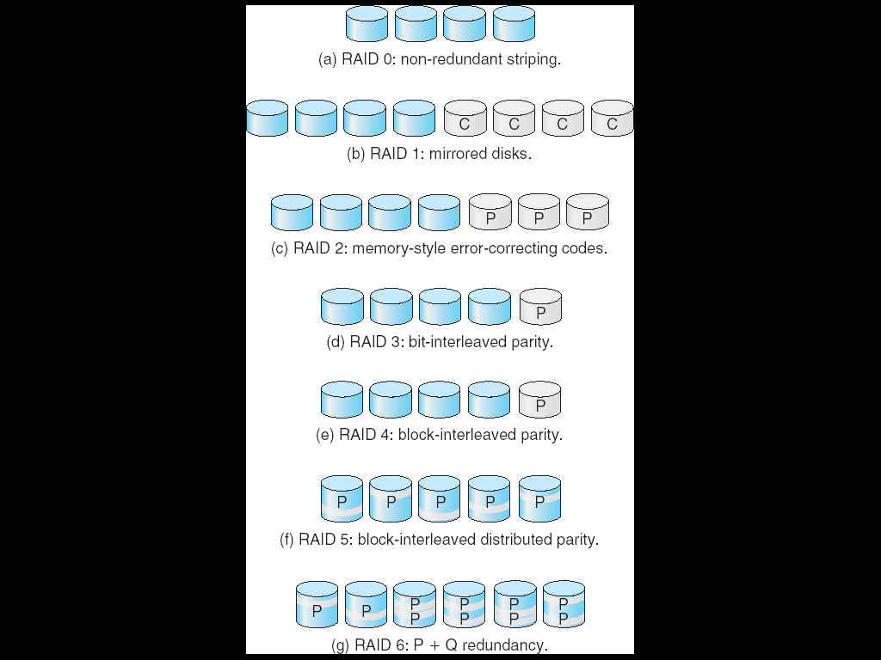
12.7.3 RAID Levels
傲腾黑科技，
利用一个磁盘实现RAID
早期
现在

Slide 59
RAID (cont)
RAID的分级
(a) RAID 0：无冗余的磁盘阵列
数据块级分散，并行交叉存取，无数据冗余；
一个磁盘出错，整个磁盘系统就无法使用
(b) RAID 1：磁盘镜像
每个磁盘有一个镜像盘；
(c) RAID 2：内存方式的差错纠正代码结构
有的内存提供奇偶校验及纠错功能
memory-style error-correcting code (ECC)
The idea of ECC can be used directly in disk arrays via striping of bytes across disks
数据位级分散，另外几个盘作为校验盘；并行交叉存取；
如果校验位足够多，可以提供纠错功能（CRC、海明码等）；
因而具有检错与纠错功能；

Slide 60
RAID (cont)
RAID的分级
(d) RAID 3：位交织奇偶结构
数据位级分散，一个奇偶校验盘，存放扇区的校验位；
坏扇区检测
当检测到一个扇区损坏，依据其它扇区的相应位可恢复损坏的扇区；
并行交叉存取；
若奇偶校验盘损坏，数据无法恢复；
读写磁盘时校验盘是瓶颈；

Slide 61
RAID (cont)
RAID的分级
(e) RAID 4：块交织奇偶结构
数据块级分散，一个奇偶校验盘，存放其它磁盘相应块的奇偶块；
坏磁盘检测；
当检测到一个磁盘损坏，依据其它磁盘的相应块可纠正损坏的磁盘块；
若奇偶校验盘损坏，数据无法恢复；
如果多个磁盘出错，数据无法恢复(只有一个校验位，码距为2)
尽管可以并行交叉存取，但比RAID3效率低：读一个数据块时只在一个磁盘上操作；写磁盘时校验盘是瓶颈；
但磁盘恢复在块级，比RAID 3容易；

Slide 62
RAID (cont)
RAID的分级
(f) RAID 5：分布式块交织奇偶结构
数据块级分散，奇偶校验块也分布在所有磁盘上；
坏磁盘检测:当检测到一个磁盘损坏，依据其它磁盘的相应块可纠正损坏的磁盘块；
避免RIAD 4中奇偶校验盘的过度使用；
如果多于一个磁盘出错，数据无法恢复(只有一个校验位，码距为2)
与RAID 4类似，尽管可以并行交叉存取，但比RAID 3效率低
但磁盘恢复在块级，比RAID 3容易；

Slide 63
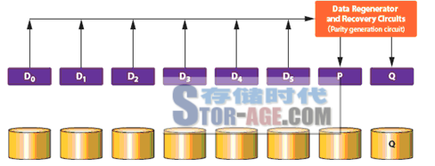
(g) RAID 6（6D + 2P）校验位生成

Slide 64
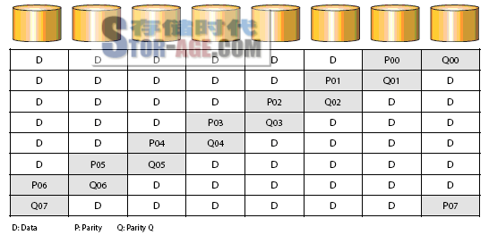
RAID 6 （6D + 2P）的数据分布

Slide 65
RAID 6：P+Q冗余方案
和RAID 5相似，RAID 6 根据条带化的数据生成校验信息；
条带化数据和校验数据一起分散存储到RAID组的各个磁盘上。
D0，D1，D2，D3，D4和D5是条带化的数据，P代表校验数据，Q是第二份校验数据。
RAID 6校验数据生成公式（P和Q）：
P的生成用了异或： （1）
P = D0 XOR D1 XOR D2 XOR D3 XOR D4 XOR D5
Q的生成用了系数异或 ： （2）
Q = A0*D0 XOR A0*D1 XOR A0*D2 XOR A0*D3 XOR A0*D4 XOR A0*D5
其中，
D0～D5：条带化数据
A0～A5：系数
XOR：异或
*：乘

Slide 66
RAID 6（6D + 2P）校验位生成

Slide 67
在RAID 6中，当有1块磁盘出故障的时候，利用公式1恢复数据，这个过程是和RAID 5一样的。
而当有2块磁盘同时出故障的时候，就需要同时用公式1和公式2来恢复数据。
在Q的计算公式中，各系数A0～A5是线性无关的系数，在D0，D1，D2，D3，D4，D5，P，Q中有两个未知数的情况下，也可以联列求解两个方程得出两个未知数的值。
这样在一个RAID组中有两块磁盘同时坏的情况下，也可以恢复数据。
上面描述的是校验数据生成的算法。RAID 6的核心就是有两份检验数据，以保证两块磁盘同时出故障的时候，也能保障数据的安全。

Slide 68
RAID 6 （6D + 2P）的数据分布

Slide 69
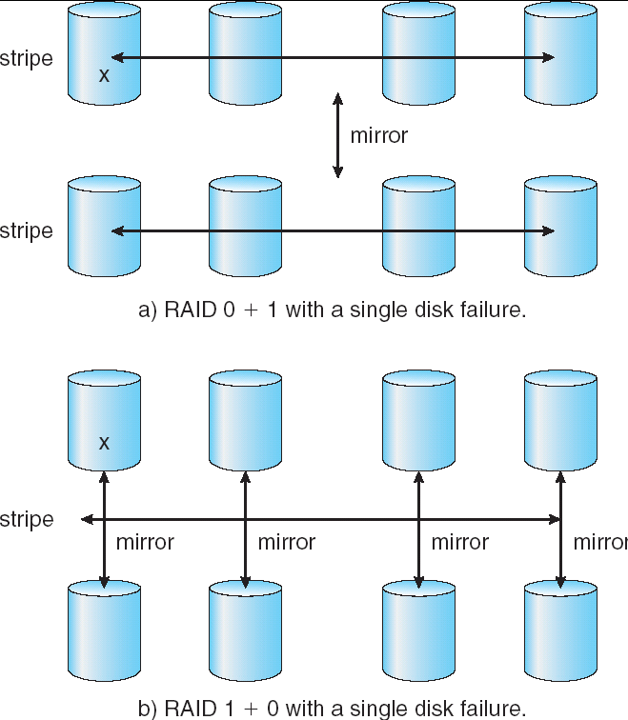
RAID (0 + 1) and (1 + 0)

Slide 70
RAID方案的选择
数据重构
RAID 0数据无法重构
RAID 1数据重构容易，但成本高
其它级别需要读入所有阵列中的其它磁盘才能重构
应用背景
RAID 0－适于性能要求高但数据可靠性要求不高的应用；
RAID 1－适于可靠性要求高和快速恢复的应用；
RAID (0+1) 和 (1+0)－适于性能和可靠性要求都高的应用；例如小型数据库服务器；
RAID 5－用于存储量大的数据；
RAID 6－较少有支持；

Slide 71
讨论：Operating System Issues
Major OS jobs are to manage physical devices and to present a virtual machine abstraction to applications
For hard disks, the OS provides two abstraction:
Raw device – an array of data blocks.
File system – the OS queues and schedules the interleaved requests from several applications.
DBMA
Raw device or File system ？

Slide 72
12.8 Stable-Storage Implementation
Write-ahead log scheme requires stable storage.
To implement stable storage:
Replicate information on more than one nonvolatile storage media with independent failure modes.
Update information in a controlled manner to ensure that we can recover the stable data after any failure during data transfer or recovery.

Slide 73
12.9 Tertiary Storage Devices
Low cost is the defining characteristic of tertiary storage.
Generally, tertiary storage is built using removable media
Common examples of removable media are floppy disks and CD-ROMs; other types are available.

Slide 74
Removable Disks
Floppy disk — thin flexible disk coated with magnetic material, enclosed in a protective plastic case.
Most floppies hold about 1 MB; similar technology is used for removable disks that hold more than 1 GB.
Removable magnetic disks can be nearly as fast as hard disks, but they are at a greater risk of damage from exposure.

Slide 75
Removable Disks (Cont.)
A magneto-optic disk records data on a rigid platter coated with magnetic material.
Laser heat is used to amplify a large, weak magnetic field to record a bit.
Laser light is also used to read data (Kerr effect).
The magneto-optic head flies much farther from the disk surface than a magnetic disk head, and the magnetic material is covered with a protective layer of plastic or glass; resistant to head crashes.
Optical disks do not use magnetism; they employ special materials that are altered by laser light.

Slide 76
WORM Disks
The data on read-write disks can be modified over and over.
WORM (“Write Once, Read Many Times”) disks can be written only once.
Thin aluminum film sandwiched between two glass or plastic platters.
To write a bit, the drive uses a laser light to burn a small hole through the aluminum; information can be destroyed by not altered.
Very durable and reliable.
Read Only disks, such ad CD-ROM and DVD, com from the factory with the data pre-recorded.

Slide 77
Tapes
Compared to a disk, a tape is less expensive and holds more data, but random access is much slower.
Tape is an economical medium for purposes that do not require fast random access, e.g., backup copies of disk data, holding huge volumes of data.
Large tape installations typically use robotic tape changers that move tapes between tape drives and storage slots in a tape library.
stacker – library that holds a few tapes
silo – library that holds thousands of tapes
A disk-resident file can be archived to tape for low cost storage; the computer can stage it back into disk storage for active use.

Slide 78
Operating System Issues
Major OS jobs are to manage physical devices and to present a virtual machine abstraction to applications
For hard disks, the OS provides two abstraction:
Raw device – an array of data blocks.
File system – the OS queues and schedules the interleaved requests from several applications.

Slide 79
Application Interface
Most OSs handle removable disks almost exactly like fixed disks — a new cartridge is formatted and an empty file system is generated on the disk.
Tapes are presented as a raw storage medium, i.e., and application does not not open a file on the tape, it opens the whole tape drive as a raw device.
Usually the tape drive is reserved for the exclusive use of that application.
Since the OS does not provide file system services, the application must decide how to use the array of blocks.
Since every application makes up its own rules for how to organize a tape, a tape full of data can generally only be used by the program that created it.

Slide 80
Tape Drives
The basic operations for a tape drive differ from those of a disk drive.
locate positions the tape to a specific logical block, not an entire track (corresponds to seek).
The read position operation returns the logical block number where the tape head is.
The space operation enables relative motion.
Tape drives are “append-only” devices; updating a block in the middle of the tape also effectively erases everything beyond that block.
An EOT mark is placed after a block that is written.

Slide 81
File Naming
The issue of naming files on removable media is especially difficult when we want to write data on a removable cartridge on one computer, and then use the cartridge in another computer.
Contemporary OSs generally leave the name space problem unsolved for removable media, and depend on applications and users to figure out how to access and interpret the data.
Some kinds of removable media (e.g., CDs) are so well standardized that all computers use them the same way.

Slide 82
Hierarchical Storage Management (HSM)
A hierarchical storage system extends the storage hierarchy beyond primary memory and secondary storage to incorporate tertiary storage — usually implemented as a jukebox of tapes or removable disks.
Usually incorporate tertiary storage by extending the file system.
Small and frequently used files remain on disk.
Large, old, inactive files are archived to the jukebox.
HSM is usually found in supercomputing centers and other large installations that have enormous volumes of data.

Slide 83
Speed
Two aspects of speed in tertiary storage are bandwidth and latency.
Bandwidth is measured in bytes per second.
Sustained bandwidth – average data rate during a large transfer; # of bytes/transfer time. Data rate when the data stream is actually flowing.
Effective bandwidth – average over the entire I/O time, including seek or locate, and cartridge switching. Drive’s overall data rate.

Slide 84
Speed (Cont.)
Access latency – amount of time needed to locate data.
Access time for a disk – move the arm to the selected cylinder and wait for the rotational latency; < 35 milliseconds.
Access on tape requires winding the tape reels until the selected block reaches the tape head; tens or hundreds of seconds.
Generally say that random access within a tape cartridge is about a thousand times slower than random access on disk.
The low cost of tertiary storage is a result of having many cheap cartridges share a few expensive drives.
A removable library is best devoted to the storage of infrequently used data, because the library can only satisfy a relatively small number of I/O requests per hour.

Slide 85
Reliability
A fixed disk drive is likely to be more reliable than a removable disk or tape drive.
An optical cartridge is likely to be more reliable than a magnetic disk or tape.
A head crash in a fixed hard disk generally destroys the data, whereas the failure of a tape drive or optical disk drive often leaves the data cartridge unharmed.

Slide 86
Cost
Main memory is much more expensive than disk storage
The cost per megabyte of hard disk storage is competitive with magnetic tape if only one tape is used per drive.
The cheapest tape drives and the cheapest disk drives have had about the same storage capacity over the years.
Tertiary storage gives a cost savings only when the number of cartridges is considerably larger than the number of drives.

Slide 87
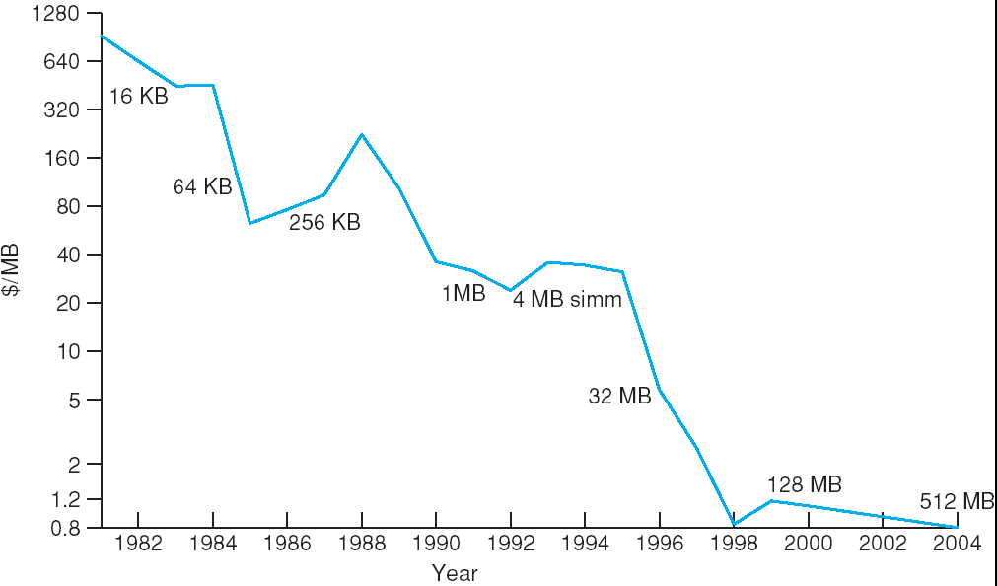
Price per Megabyte of DRAM, From 1981 to 2004

Slide 88
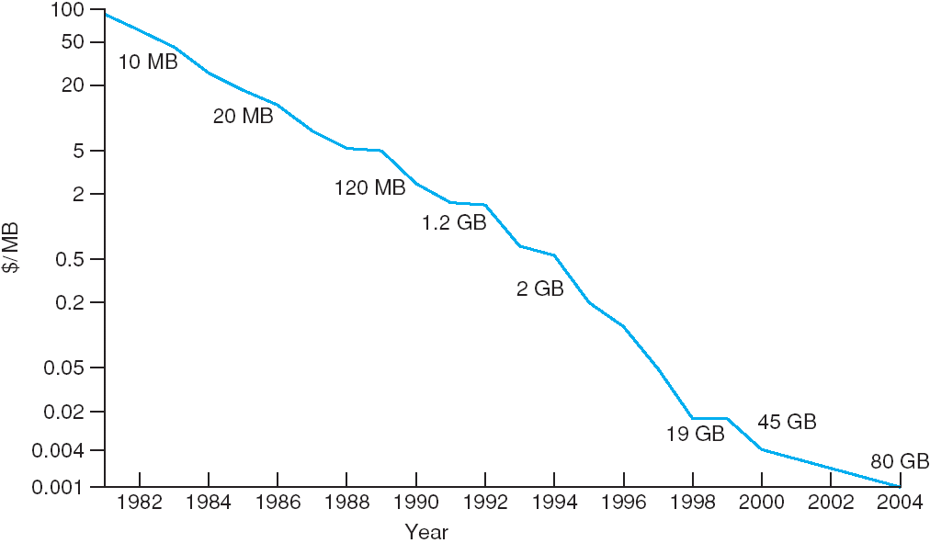
Price per Megabyte of Magnetic Hard Disk, From 1981 to 2004

Slide 89
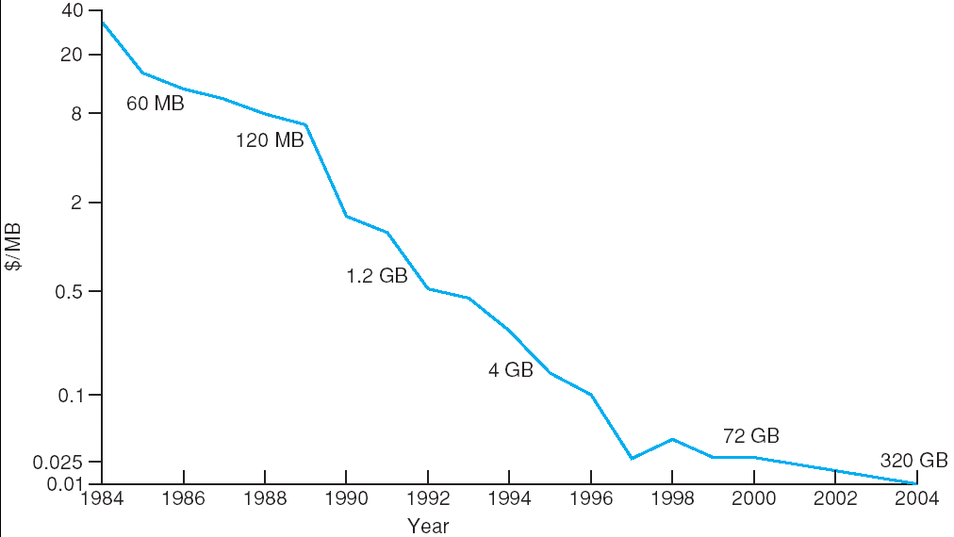
Price per Megabyte of a Tape Drive, From 1984-2000

Slide 90
课后复习题
思考
几种种磁盘调度算法的思想、特点及相关的计算；
RAID的概念、基本思想及特点；
Page 489
1,2,7,8,9,10
进一步了解 Page 489 3,4,6,11

Slide 91
End of Chapter 12

